Slide 1

Data Warehousing and Analytics: AWS vs. Snowflake vs. Databricks
Cloud-based data solutions are evolving rapidly. Each platform offers unique advantages for data engineers and decision-makers.
We'll explore pricing models, scalability features, and data handling capabilities across three major platforms.
Vinod Samala

Slide 2
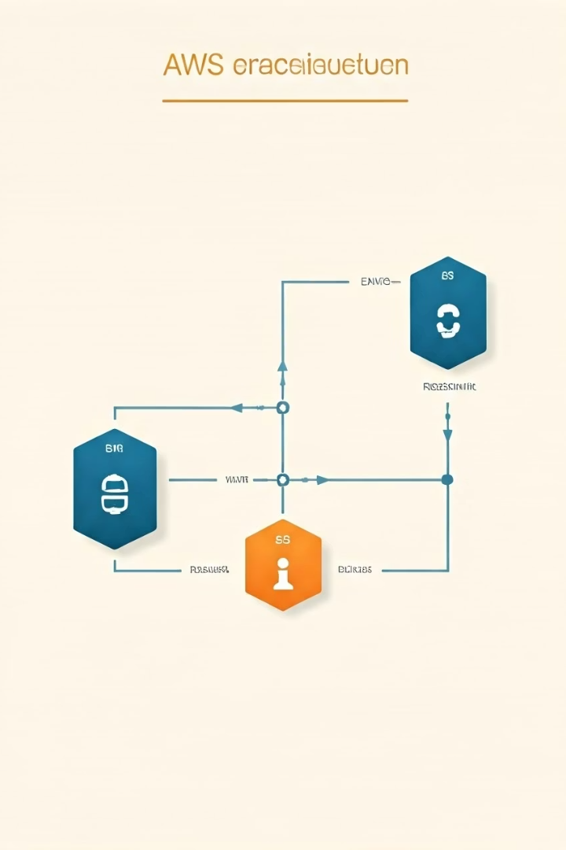
Architecture Overview: AWS EMR + Redshift + S3
AWS EMR
Amazon Redshift
Processes big data workloads using Hadoop/Spark frameworks. Handles ETL operations efficiently.
Fully managed data warehouse optimized for analytics. Column-based storage enhances query performance.
Amazon S3
Provides virtually unlimited object storage. Serves as a central data lake repository.
Vinod Samala

Slide 3






Architecture Overview: Snowflake
Multi-cluster shared data
Global data sharing across regions
Storage layer
Optimized columnar storage format
Compute layer
Virtual warehouses for independent scaling
Vinod Samala

Slide 4
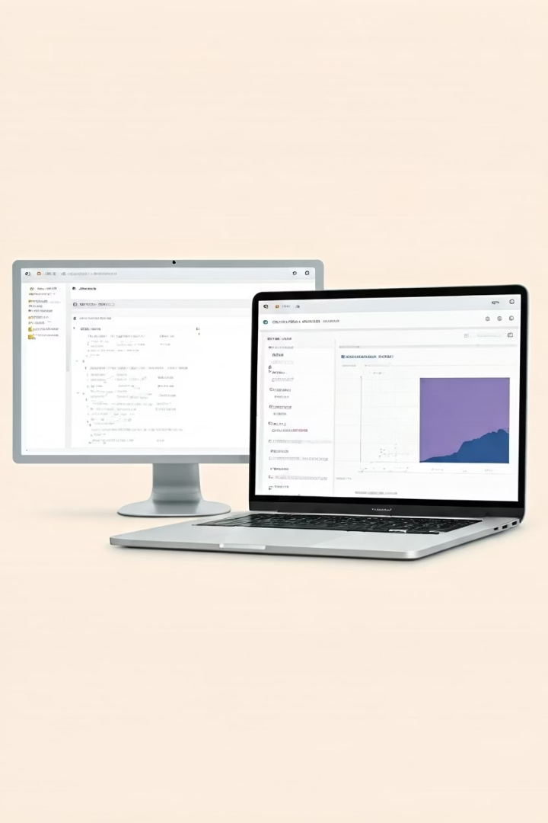




Architecture Overview: Databricks
Apache Spark foundation
Unified analytics engine for large-scale data processing
Delta Lake
ACID transactions and versioning on data lakes
Collaborative notebooks
Python, R, SQL, and Scala support
MLflow integration
End-to-end machine learning lifecycle

Slide 5

Pricing Comparison
Platform
Pricing Model
Typical Costs
AWS
Pay-as-you-go
$5/hour EMR, $0.023/GB S3
Snowflake
Credit-based
$2-$12/credit by edition
Databricks
DBU-based
$0.40-$3.00/DBU by instance
Vinod Samala

Slide 6

Scalability and Performance
100+ PB
EB+
Snowflake
Databricks
Automatic virtual warehouse scaling
Auto-scaling Spark clusters
PB+
AWS
Manual EMR and Redshift scaling

Slide 7






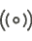

Data Volume and Type Handling
Structured Data
Semi-structured
All platforms excel at traditional table formats
Snowflake and Databricks offer native JSON support
Unstructured
Streaming
S3 stores any format; processing varies by platform
Databricks offers best real-time capabilities
Vinod Samala

Slide 8




Choosing the Right Solution
Choose AWS when:
Choose Snowflake when:
Choose Databricks when:
You're already invested in AWS ecosystem. Cost control is critical for predictable workloads.
You need immediate scalability. Data sharing across organizations is important. Supports Spark, Notebooks, Scheduling and ML.
Advanced analytics and ML are priorities. Your team has Spark expertise.
Vinod Samala

